Slide 1
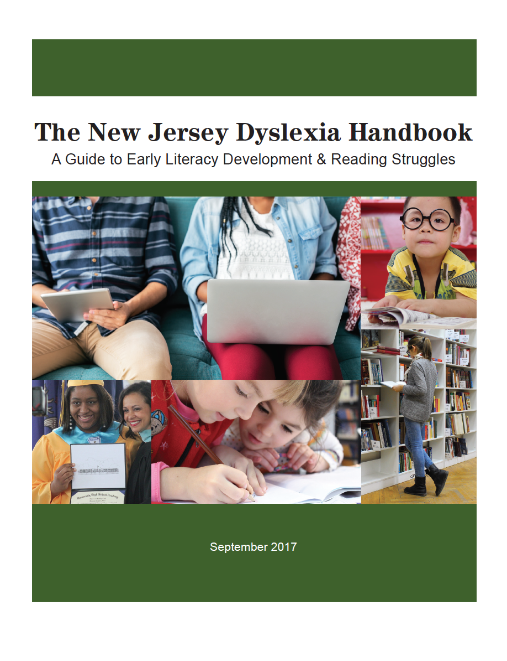
Exploring The New Jersey Dyslexia Handbook: A Guide to Early Literacy Development & Reading Struggles
Session 2
Notes:
Welcome to session 2 of the webinar series “Exploring the New Jersey Dyslexia Handbook: A Guide to Early Literacy Development and Reading Struggles.” This four part webinar series is designed to help school districts become familiar with the guidance contained in the state handbook and to support district-based stakeholder teams in making the best educational programming decisions for the students in their schools. This series can be used as an implementation tool for districts interested in building a strong preventive model of screening and tiered intervention for students struggling in the area of reading. Each installment will provide team members with an overview of content and activities to support the team members in translating the information discussed into best practices in their schools and classrooms.
In this second installment, we will review the universal screening and early dyslexia screening section of the handbook.

Slide 2
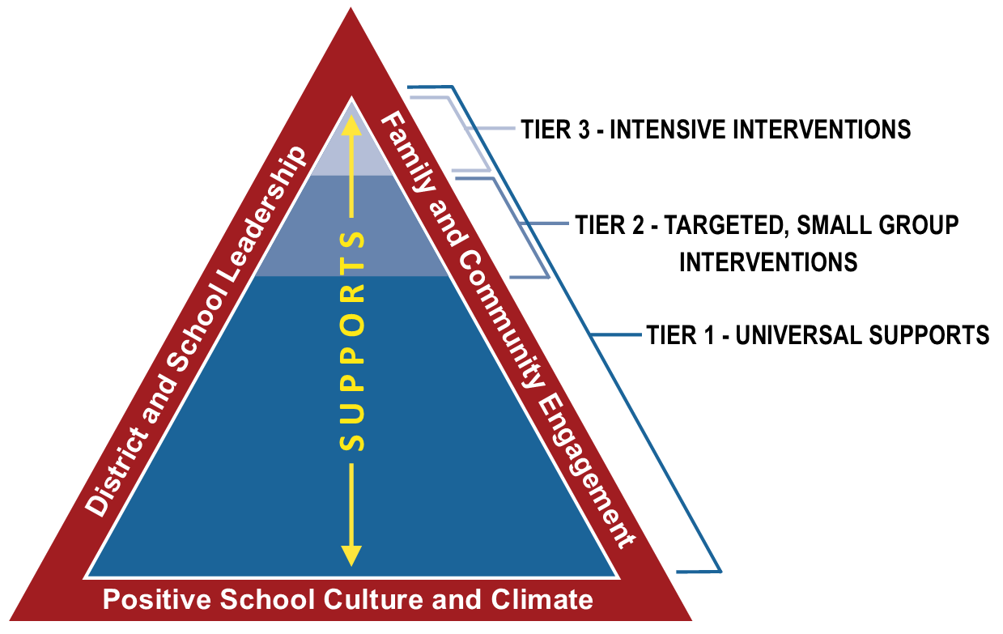
Universal Screening - NJTSS
Notes:
Reading researcher, Joe Torgesen stated in his 1998 article, Catch Them Before They Fall, that “the best solution to the problem of reading failure is to allocate resources for early identification and prevention.”
This stance is supported by a multi-tiered systems of support model such as the NJTSS best practice model. NJTSS is a framework for a data-driven, prevention-based approach to literacy instruction.

Slide 3
Universal Screening - NJTSS
Screening for all K-3 students in the beginning, middle, and end of school year; regardless of student performance
Identifies students at-risk for future reading failure and in need of Tier 2 or 3 interventions
Provides information regarding the effectiveness of the Tier 1 core instruction
Provides information on skill-specific needs relative to the 5 components of reading: phonological awareness, phonics, fluency, vocabulary, and comprehension
Notes:
It includes universal reading screening for all students in Kindergarten through Grade 3 administered at various points in the beginning, middle, and end of the school year, regardless of the student’s performance in the classroom. These are quick, efficient assessments of discrete skills that are reliable and valid, following standardized directions and scoring protocols.
The purpose of universal screening is to identify students at risk for future reading failure. This is not a diagnostic assessment intended to identify a student as having a learning disability or dyslexia. Universal screening procedures alert us to which students are at-risk for reading failure including students who are in need of intervention but who do not have a learning disability.
Universal screening results can also give us information regarding the effectiveness of the school’s core instruction. If a high percentage of students in a particular grade are identified as needing tier 2 interventions, a review may be needed of the core instruction being implemented in Tier 1.
And it also provides information on skill-specific needs relative to the 5 components of reading: phonological awareness, phonics, fluency, vocabulary, and comprehension.

Slide 4
Universal Screening
Family History of Reading Disorder or Dyslexia
Kindergarten:
Phonological Awareness
Rapid Automatic Naming
Sound-Letter Identification
Phonological Memory
First Grade:
Phonemic Awareness
Rapid Automatic Naming
Sound-Letter Identification
Phonological Memory
Oral Vocabulary
Word Recognition Fluency
Oral Reading Fluency (Middle of Year)
Second Grade:
Word Reading
Real and Nonsense Words
Oral Reading Fluency
Reading Comprehension
Notes:
First it should be noted that dyslexia is strongly heritable, occurring in up to 50% of individuals who have a first-degree relative with dyslexia and the risk and severity is higher when both parents are affected. Therefore, a family history of reading disorders or dyslexia should be considered a “red flag” indicating that the student may struggle to acquire early reading skills and should be monitored closely.
Additionally, research has identified the skills that are the best predictors of future reading difficulties for grades K through 2.
In Kindergarten, universal screening should include measures of phonological awareness, rapid automatic naming, sound-letter identification, and phonological memory.
In First Grade, universal screening should include measures of phonemic awareness, rapid automatic naming, sound-letter identification, phonological memory, oral vocabulary, and word recognition fluency. And by mid year, a measure of oral reading fluency should be included.
In Second Grade, universal screening should include measures of word reading including both real and nonsense words, oral reading fluency, and reading comprehension.
It is important to note that there is no one test or assessment tool that would measure all reading skills. Different assessments measure different discrete skills. And another important consideration should be the use of both timed and untimed measures, looking at the student’s accuracy as well as their automaticity in performing the task.

Slide 5
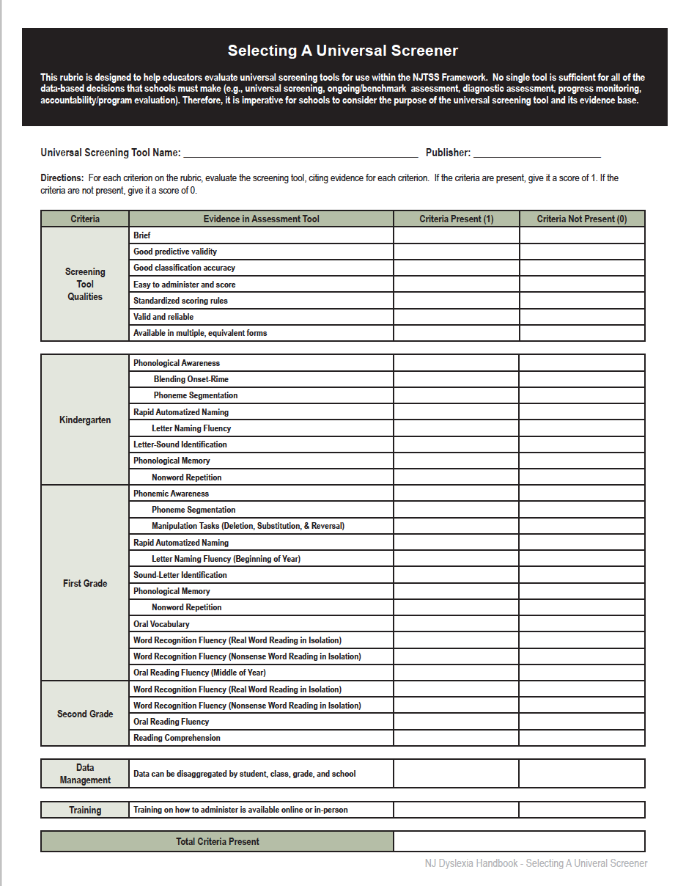
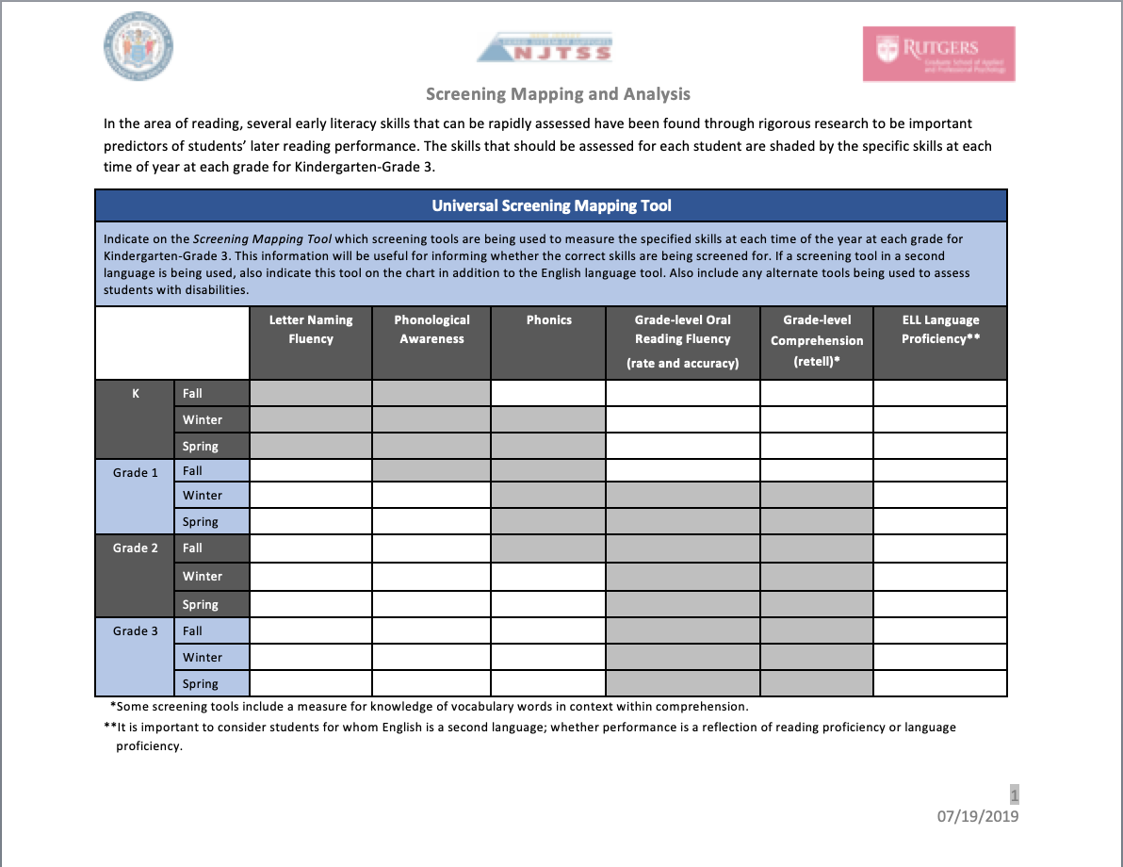
Activity:
Choosing Your Screening Tools
Classification Accuracy
Predictive Validity
⇨ TOOL: Selecting A Universal Screener
⇨ TOOL: NJTSS Screening Mapping and Analysis
⇨ TOOL: NJTSS Screening Action Plan
Notes:
Districts should consider the use of multiple measures for screening purposes to ensure that all identified skills have been assessed at the appropriate grade level. Universal screening procedures can utilize formal screening tools created by educational publishers as well as some screening tools that are informal in nature. When multiple measures are used to screen students, the accuracy of classification for who is “at-risk” improves significantly. Tools selected for universal screening purposes need to have good classification accuracy, meaning it accurately classifies students into “at risk” and “not at risk” categories, and predictive validity, meaning it accurately measures skills that predict future reading performance.
Utilizing the tool provided in the handbook titled Selecting A Universal Screener, or the NJTSS Screening Mapping and Analysis tool your school- or district-based team can use this next activity to translate the information discussed today to make evidenced-informed decisions about your current screening tools and practices and to make note of any additional screening tools you may need to consider adding to your NJTSS model. After your team has analyzed your current screening tools, please note that a NJTSS Screening Action Plan template is also available to help document and plan for your next steps in implementation.
More resources and information on screening can be found on the Center on Response to Intervention website. A link to their Screening Briefs is provided in the handbook.
Lastly, it is important to remember that training your school personnel on how to effectively use and administer a selected screening tool is essential to ensuring the data collected are valid and reliable.

Slide 6
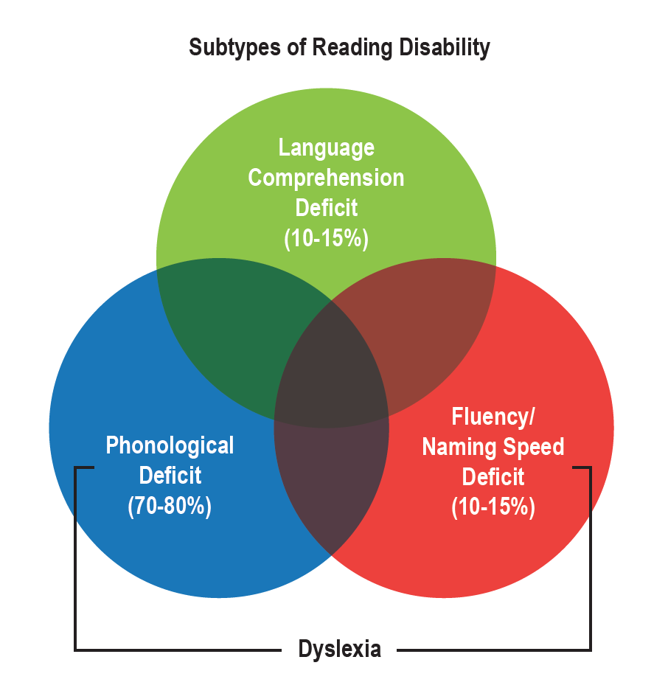
Developmental
Reading Disabilities
70-80%
10-15%
Notes:
Once data from universal screening has been collected and reviewed, students who are identified as “at-risk” for future reading difficulties should begin receiving tiered Structured Literacy intervention and regular progress monitoring. In addition, these students should also be screened for dyslexia.
Extensive research documents the role of phonemic awareness and the influence of rapid automatized naming, or RAN in the development of reading skills. These two skills have been identified as the best predictors of dyslexia.
Reviewing this Venn diagram included in the handbook, the blue circle represents individuals who show difficulties with accurate and/or fluent word reading due to a phonological processing deficit. The red circle represents individuals who have accurate word recognition skills but have difficulty with automatic or fluent word recognition and phonetic spelling. These two circles represent individuals with dyslexia with the blue circle representing 70-80% of people with dyslexia and the red circle representing 10-15% of people with dyslexia.
There are also those individuals with dyslexia that have weaknesses in both areas. Therefore, the universal screening data on phonemic awareness and RAN is important information to be considered during a screening for dyslexia in kindergarten through second grade.

Slide 7
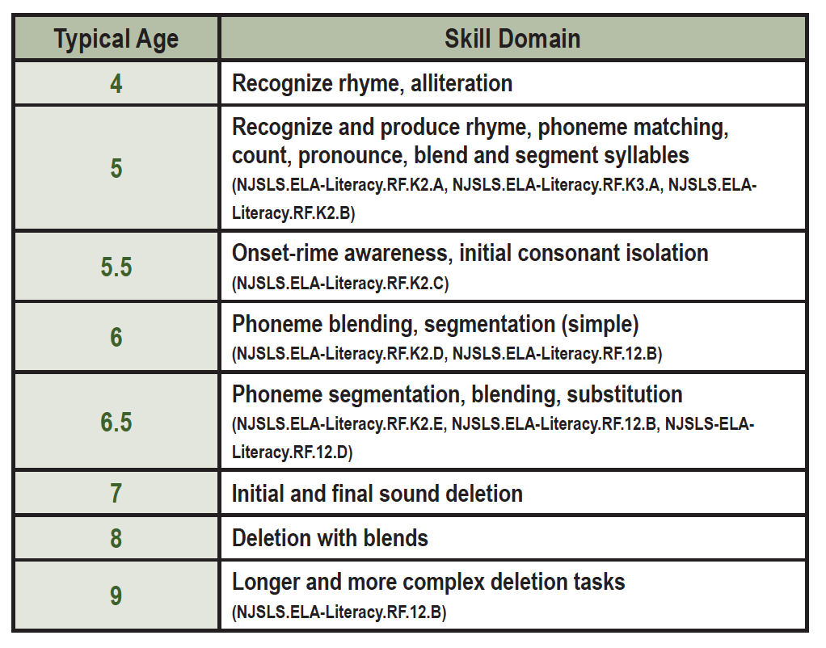
Early Dyslexia Screening
Kindergarten through Grade 2:
Universal screening data
Continuum of phonological awareness skills
More thorough look at word recognition skills including decoding and encoding (spelling) skills
Oral reading fluency (accuracy and rate)
Oral vocabulary skills compared to written vocabulary skills
Notes:
When screening kindergarten and first grade students for dyslexia, further assessments of phonological awareness and phonemic awareness may be given to determine the specific point of difficulty on the phonological awareness continuum. Depending on the phonological awareness skill assessed on the universal screener (typically we see measures of phoneme segmentation), additional measures to identify skills with rhyming words, beginning, ending and medial sounds, and blending tasks may be given. Additional measures such as substitution and deletion tasks which require more advanced phonemic awareness skills can also be administered.
A more thorough look at word recognition skills should include real word reading, nonsense word reading, and a spelling assessment. Informal phonics surveys and developmental spelling inventories can provide additional information in these areas. In addition to administering the spelling assessment, spelling errors should be analyzed to determined which phonological and orthographic patterns the student has not mastered.
An oral reading fluency measure should be given beginning in the middle of first grade that looks at both accuracy and rate. These probes are usually quick 1 minute timed readings of grade level passages with the examiner noting the number of errors. Typically three passages are administered to determine the median score. Rate scores are computed in words correct per minute. Performance in terms of rate can be compared to norms established by Hasbrouck and Tindal in 2017 or to the norms established by the publisher where you obtained the fluency probes.
In addition to word recognition skills, some informal reading inventories offer measures of oral and reading vocabulary. Assessments can also be obtained by consulting your speech-language pathologist at your school. Measures could include a naming task of pictured objects, or asking students to produce synonyms and antonyms for orally presented words compared with asking students to read words and produce synonyms and antonyms. Comparing results may provide information that shows a stronger oral vocabulary compared to reading vocabulary which is another indicator of a print-based reading difficulty.
Typically students with higher level cognitive abilities may mask reading difficulty by using their strong reasoning ability; this is especially true at the younger grades and we should be on the lookout.

Slide 8
Dyslexia Screening
Third Grade and Beyond:
Review of district benchmark and statewide assessments
Oral reading fluency (accuracy and rate)
Encoding (spelling) skills
Listening comprehension skills compared to reading comprehension skills
Notes:
Students in grade 3 and higher may participate in district benchmark assessments in the area of reading. The data from these assessments can be reviewed to identify students who are performing below expectations. Results from these assessments may be used to determine which students may be in need of screening for dyslexia. Students who perform adequately on these assessments but demonstrate poor performance in the classroom may be screened as well. A student’s performance on statewide assessments could also be used as an indicator that additional screening is needed.
Students beyond grade 3 may also be struggling in discrete areas such as phonemic awareness, decoding, encoding and word recognition skills. A review of the student’s early literacy benchmark data from early grades is important.
When screening students in grade 3 and higher for dyslexia, oral reading fluency rate as well as facility with spelling may be most useful in identifying students in need of intervention. In addition, timed assessments that measure how accurately and fluently a student can read real words and nonsense words provide scores that can be compared to age based norms. These timed assessments are usually quick 45 second probes. Poor performance on these measures may be due to phonological processing deficits and/or weak orthographic mapping skills resulting in a poor sight word bank of instantly recognized words - in other words, dyslexia.
Additionally, students with dyslexia often demonstrate a higher level of listening comprehension as compared to reading comprehension.

Slide 9
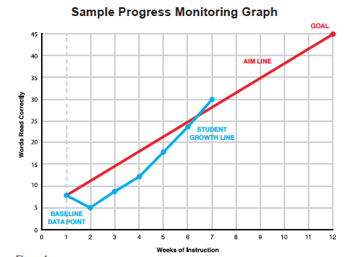
Progress Monitoring
The student’s response to intervention:
Progress should be monitored frequently, at least monthly, but ideally weekly or biweekly (Fuchs & Fuchs, 2006)
Should be monitored with age appropriate measures
Should be measured in comparison to set goals, with scores plotted on a line graph, and data analyzed based on national norms when available
Notes:
When students are provided a Tier 2 or Tier 3 Structured Literacy intervention, their response to that chosen intervention also referred to as their rate of improvement should be monitored. According to the Institute of Education Science (IES) Practice Guide, Assisting Students Struggling with Reading: Response to Intervention and Multi-Tier Intervention in the Primary Grades, it is recommended that progress should be monitored frequently, at least monthly, but ideally weekly or biweekly. Probes should be general outcome measures, such as those used for universal screening or skill based measures that focus on a discrete set of skills.
Measures to use for kindergarten progress monitoring should include phoneme segmentation and letter naming fluency. For first grade and second grade, real word and nonsense word reading and oral reading fluency probes should be used.
Data from progress monitoring should be graphed using a line graph. Typically the vertical axis indicates the number of correct student responses and the horizontal line indicates the number of weeks of intervention. The first set of data entered is the baseline data, typically this is the universal benchmark screening score. Then a goal is set using established national norms to compare with the student’s performance over time. The baseline and goal data points are connected establishing the student’s aimline.
As probes are incrementally administered to students, the scores are plotted on the graph and points are connected. If multiple consecutive data points fall below the aimline, then a decision regarding the intervention needs to be made. These decisions can include things such as adjusting group size, increasing the frequency of intervention sessions, or increasing the duration of the currently provided intervention period.

Slide 10
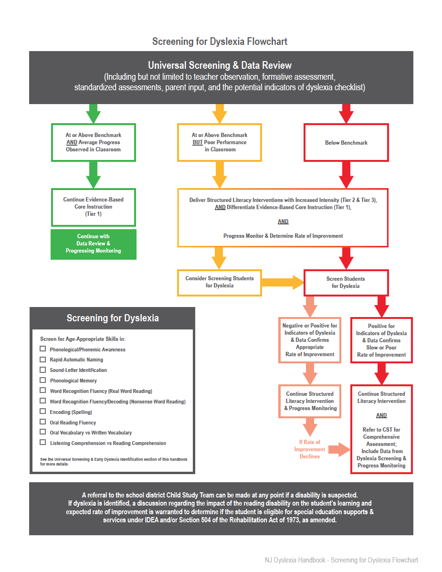
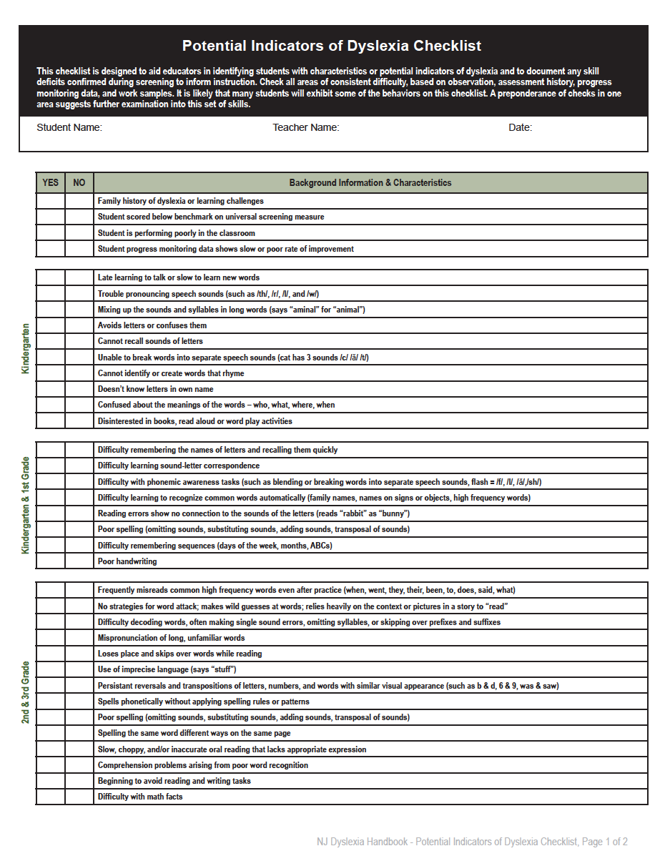
Activity:
Establish A Screening Process
⇨ TOOL: Screening for Dyslexia Flowchart
⇨ TOOL: Potential Indicators of Dyslexia Checklist
Notes:
As we bring this second session of the webinar series to a close, we will leave you with a new follow up activity. Remember, these activities are intended to support your team members in translating the information discussed today into best practices in your schools and classrooms.
The NJ dyslexia screening law states that boards of education shall ensure that each student enrolled in the school district who has exhibited one or more potential indicators of dyslexia or other reading disabilities is screened for dyslexia and other reading disabilities. Included in the dyslexia handbook is the Screening for Dyslexia Flowchart and the Potential Indicators of Dyslexia Checklist. Your school- or district-based team can use these tools to translate the information discussed today to make evidenced-informed decisions as you establish or fine-tune your current screening processes and practices. The flowchart gives an “at-a-glance” look at identifying “at risk” students through universal reading screening procedures, promptly placing students into structured literacy interventions, monitoring student progress, and screening students for dyslexia. The potential indicator checklist provides a quick tool for classroom teachers to identify early characteristics of dyslexia.
Take some time to think about how these tools can be used in your school to design a preventive system of screening and tiered intervention support for struggling readers including those with dyslexia.

Slide 11
Thank You!
Reminder: Complete the activities included here and then tune in for Session 3
Notes:
We’ll look forward to having you explore session 3 of “Exploring the New Jersey Dyslexia Handbook: A Guide to Early Literacy Development and Reading Struggles” in the near future.

